Slide 1


Machine Intelligence
VC Dimension
Dr. Arti Arya
Department of Computer Science
artiarya@pes.edu
+080-66186629 Extn 6629

Slide 2
MACHINE INTELLIGENCE
VC Dimension
Dr. Arti Arya
Department of Computer Science and Engineering

Slide 3
MACHINE INTELLIGENCE
Vapnik Chervonenkis Dimension
As in PAC learning, we have seen that
m ≥ (ln |H|+ln(1/δ))/ ε---------(1)
That is, we can say that “the complexity of sample for PAC learning increases as natural log of size of H, log of 1/δ and linearly in 1/ ε .”
Example:
Consider a classification function, f:X→Y. Some instances X=<X1,X2,X3,X4>, Xi is boolean. Each hypothesis in H is in the form of a rule:
If <X1, X2, X3, X4>=<0, ?, 1, ?> then Y=1 else Y=0.
How many training examples must assure that with a prob. of 0.99, a consistent learner will give a hypothesis with a true error of at most 0.05?

Slide 4
MACHINE INTELLIGENCE
Vapnik Chervonenkis(VC) Dimension
Unfortunately, (1) has 2 major drawbacks
The bound on δ can be significantly > 1 for large |H|.( thereby making the bound weak)
(1) doesn’t work when H is infinite.

Slide 5

MACHINE INTELLIGENCE
Vapnik Chervonenkis(VC) Dimension
A general question:
When does Hypothesis space becomes infinite?
Consider 2 points having x1 and x2 as real valued attributes, clearly there could be infinite hypothesis satisfying these two points.
Clearly, the no. of linear functions segregating these points will be infinite.
Thus H becomes infinite.
For such Hypothesis space, the bound on m described earlier will not work.
So here comes for rescue------The VC dimension

Slide 6
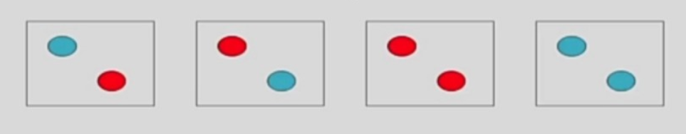
MACHINE INTELLIGENCE
Shattering
Consider an infinite hypothesis space H and a binary classification problem having class labels {Blue, Red}.
Let S be an instance set defined over X( instance space
X) having 2 data points.
Suppose model class is a line.
There are 2² ways to label these.
If there are 3 points then 2³ labelling are possible.
∴ for n points, 2^{n} possible labelling.
Each h∈ H can dichotomize elts of S.
Given some instance set S, there are 2^{|S|} possible dichotomies.
H shatters S if every possible dichotomy of S can be represented by some hypothesis ∈ H
Figure Courtesy: https://onlinecourses.nptel.ac.in/noc19_cs52/preview

Slide 7
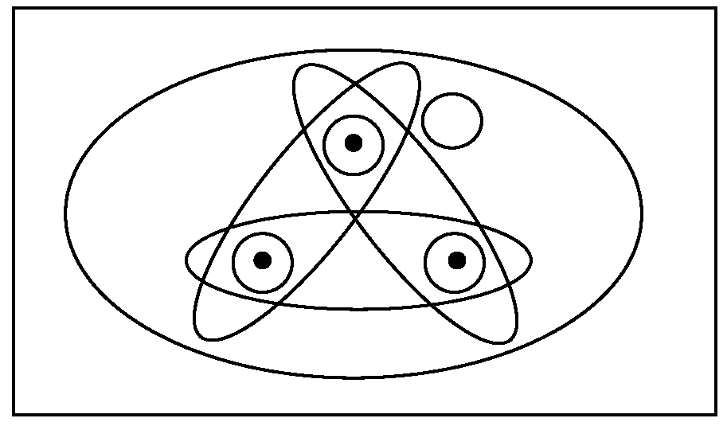
MACHINE INTELLIGENCE
Shattering
A dichotomy of a set S is a partition of S into two disjoint subsets.
Def: A set of instances S is shattered by hypothesis space H if and only if for every dichotomy of S there exists some hypothesis in H consistent with this dichotomy.
Instance Space X
Fig Courtesy: “Machine Learning” by Tom Mitchell

Slide 8
MACHINE INTELLIGENCE
Vapnik Chervonenkis Dimension
VC(H), of hypothesis space H defined over X = size of the largest finite subset of X that can be shattered by H.
If H shatters arbitrarily large finite subsets of X,
then
VC(H) ≡ ∞
NOTE:
For finite H, VC(H)≤ log₂|H|
( Say, VC(H)=d
Then H needs 2^{d} distinct hypothesis to shatter d instances. That is, 2^{d} ≤ |H|
Or d ( log₂2) ≤ log₂|H|, hence VC(H)≤ log₂|H|)

Slide 9
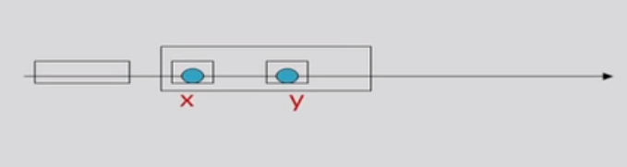
MACHINE INTELLIGENCE
Example of VC dimension
Let us consider X=R, H = a < x < b, then what is VC(H)??
Solution: Find the largest subset of X that can be shattered by H.
Consider a subset having 2 instances: S={1.5, 2.7}
Can H shatter S? Lets see
Is there a hypothesis that can cover both 1.5 and 2.7 instances?
1 < x < 4
Is there a hypothesis that can cover neither 1.5 and 2.7 ?
0<x<1
Is there a hypothesis that can cover either 1.5 or 2.7 ?
1 < x < 2 or 2 < x < 4 .
So a set of 2 pts. Can be shattered by this H.
Figure Courtesy: https://onlinecourses.nptel.ac.in/noc19_cs52/preview

Slide 10
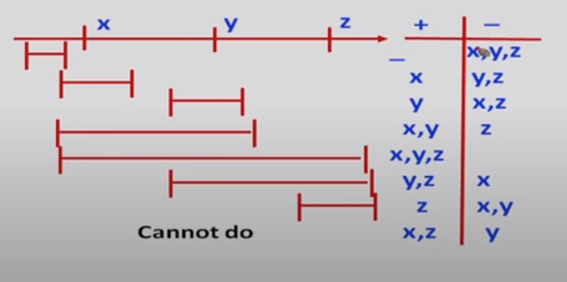
MACHINE INTELLIGENCE
Computational Learning Theory
Now lets check a set of size 3?
Let S1 = {x, y, z}
Without any loss of generality, we can assume that x <y < z .
Can H shatter these 3 points of S1?
x y z
So, clearly no subset S1 of size 3 can be shattered by this H.
∴ VC(H)=2
Figure Courtesy: https://onlinecourses.nptel.ac.in/noc19_cs52/preview

Slide 11
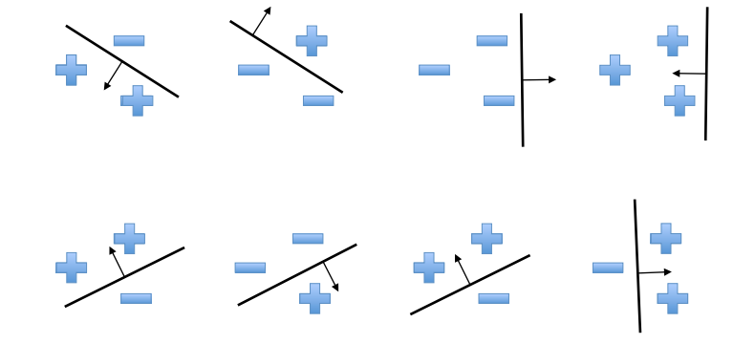
MACHINE INTELLIGENCE
Another Example of VC Dimension in 2 D space
Let X =R², H= set of all linear decision surfaces in a 2-D plane.
( H is a hypothesis space with a perceptron with 2 inputs.). VC(H)=??
Suppose our model class is a hyperplane.
Consider all labeling over three points in R²
Figure Courtesy: https://onlinecourses.nptel.ac.in/noc19_cs52/preview
In R², we can find a plane (i.e., a line) to capture any labeling of 3 points.
A 2-D hyperplane shatters 3 points.

Slide 12
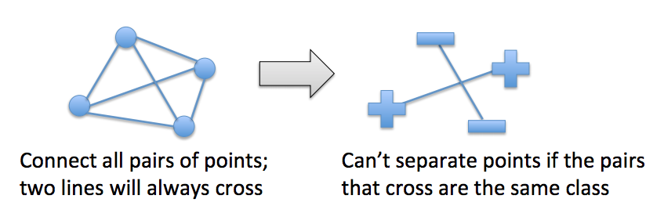
MACHINE INTELLIGENCE
An Example of VC Dimension
But a 2D hyperplane cannot deal with some labeling of 4 points:
∴ a 2D hyperplane cannot shatter 4 points.
∴ VC(H)=3
VC dimension of linear decision surfaces in an r-dimensional space( say VC dimension of a perceptron with r inputs)= r+1

Slide 13
MACHINE INTELLIGENCE
One more.......example of VC Dimension
X= conjunction of 3 boolean literals.
H= described by conjunction of upto 3 boolean literals.
VC(H)=??
Solution: Let S = {x1, x2, x3} where x is 3-bit string represented by l1, l2, l3 literals.
x1 = 1 0 0, x2 = 0 1 0, x3 = 0 0 1
This set S can be shattered by H. How?
Lets say a hypothesis is : If dichotomy is to include instance x_{i} then add literal ~l_{i} to the hypothesis.
Lets say we want to include x2 and exclude x1 and x3, then use the hypothesis
~ l1 and ~l3

Slide 14
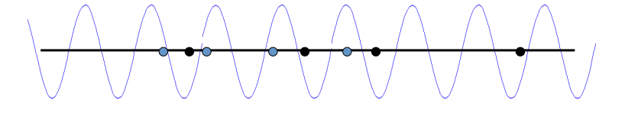
MACHINE INTELLIGENCE
Some examples of VC Dimension
A sine wave has infinite VC dimension and only 2 parameters!
By choosing the phase & period carefully, we can shatter any random set of 1D data points (except for nasty special cases)
h(x) = a sin (bx)

Slide 15
MACHINE INTELLIGENCE
Look out for some more examples of VC Dimension
Logistic regression over n continuous features
– Over n boolean features?
• Linear SVM over n continuous features
• Decision trees defined over n boolean features F: <X1, X2,…..Xn> → Y
• Decision trees of depth 2 defined over n features
• 1-nearest neighbor?

Slide 16

MACHINE INTELLIGENCE
Sample complexity and VC Dimension
For finite H, How many randomly drawn tr. Examples are sufficient to PAC learn a target concept c ∈ C?
(That means how many examples are enough to ε-exhaust the VS_{H,D} with prob. (1- δ)?)
But this was when H was finite.
There is an alternative bound on m for infinite hypothesis space H in terms of VC dimension.

Slide 17
MACHINE INTELLIGENCE
References
Nptel Lecture series on Machine Learning by Sudeshna Sarkar, IIT Kahargpur
https://www.youtube.com/watch?v=PVhhLKodQ7c&width=640&height=480
2. Machine Learning By Tom Mitchell. Published by McGraw Hill

Slide 18
THANK YOU
Dr. Arti Arya
Department of Computer Science
artiarya@pes.edu
+91 9972032451 Extn 029

